Slide 1
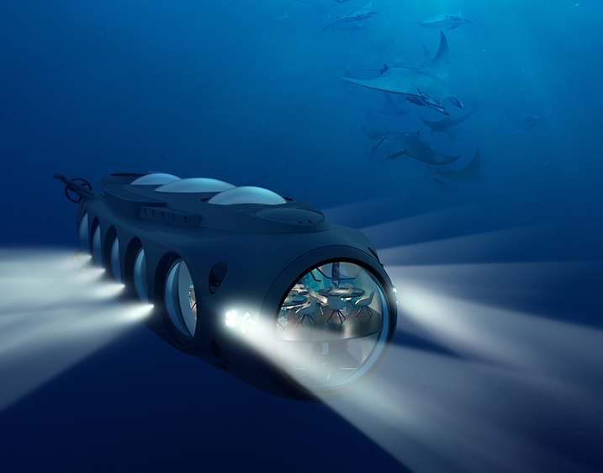
Project: Jyuratodus
Bryan Zhao, Michael Tsui, Oscar Liu, Andy Meng

Slide 2

The Purpose
As of the start of 2023, less than 10 percent of the Oceans on our planet has been discovered. While modern methods use sonar to map the oceans, our team is focused on discovering new species and anomalies that may exists on Earth.

Slide 3



Design Overview
Unique
Functional
Authentic
Never seen before design that is incredibly cost-efficient and easy to use
Simplistic and stylish design that is cost-effective and reusable
Designed with the help and input of software and hardware experts

Slide 4
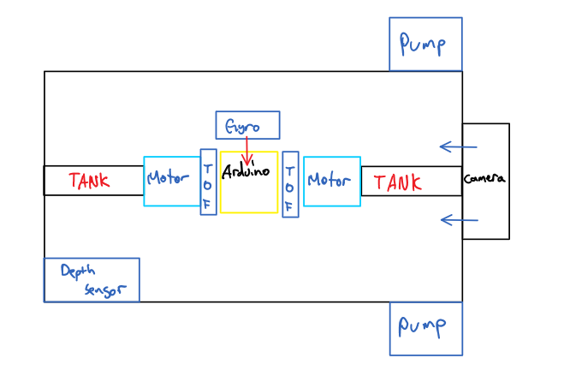
Project Design
Ballast Tank
Chassis
-Allows precise vertical movement
-Intricate and elegant design
-Holds everything together
-Watertight
Motors
Camera
-Allows for precise lateral movement
-Multi-purpose industry motors
-Python interactive
-Uses color recognition to detect anomalies

Slide 5
2-Month Action Plan
-Ballast tank Completion
-Task: Build and test Chassis
-Chassis Completion
-Task: Attach submarine movement components
-Marine Movement Completion
-Task: attach camera and gyro
-Assembly Completion
-Task: Install software movement
Pitch Date
April
4th
12th
18th
20th
24th
Received Materials, begin Engineering
Further Prototyping and Revision
Software development and integration
Open Water Test(s)
Project Deadline
May
2nd
-Software Completion
-Task: Run tests in water
16th-18th

Slide 6
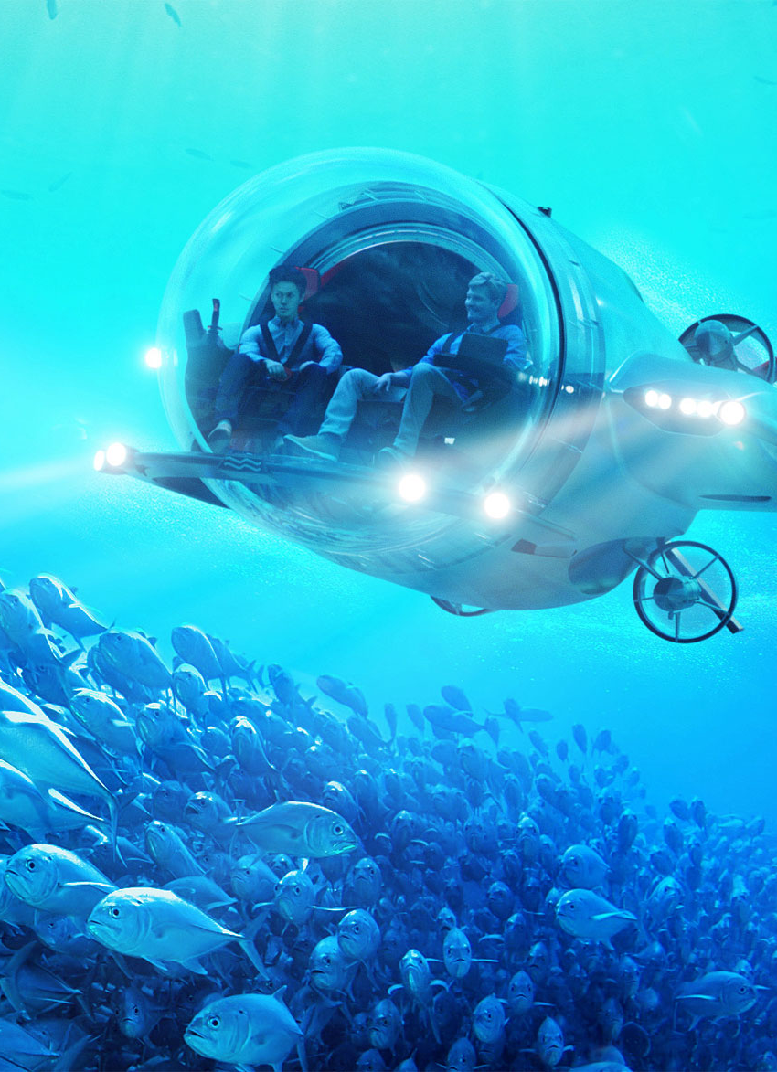
Financials:
 | # Need | PPU | PPO
Syringe | 1​ | $15.99​ | $15.99​
Acrylic Cylinder | 3 | $25.23 | $75.69
Pump | 3 | $14.98 | $44.94​
Flex Seal | 1 | $38.99​ | $38.99
Teflon Tape | 1 | $38.99​ | $38.99
Magnetic Switch | 1 | $13.99​ | $13.99​
O Ring Cord | ​2 | $​17.21 | ​$34.42
Sonic UW Dist Sensor | 2​ | $14.55 | $29.10​
Tube | 1​ | $10.49 | $10.49​
Flex Glue | 1​ | $14.99 | $14.99​
CorrosionX | 1​ | $32.60 | $32.60​
Lego Parts/3D prints | 1​​ | $39.99 | $39.99

Slide 7
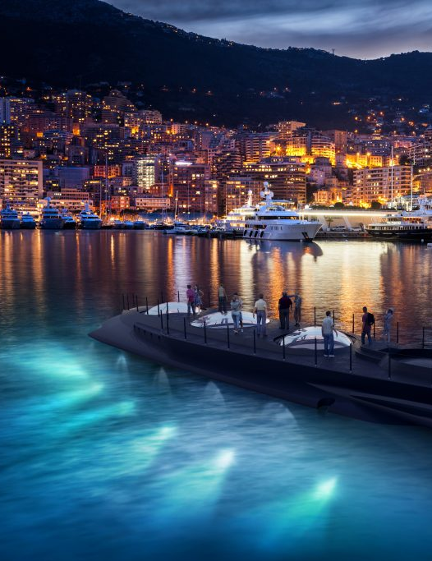
Financials:
 | # Need | PPU | PPO
ToF Distance Sensor | 4 | $15.40​ | $61.60​
Arduino Mega | 1 | $29.99 | $29.99
Various Wires | 1 | $9.99 | $9.99
MPU6050 Gyro | 1 | $11.00 | $11.00
ArduiCam | 1 | $61.56 | $61.56
Motors | 2 | $16.99​ | $33.98​
Shaft Coupler | 4 | $8.99 | $35.96
Total Expenses | ​ |  | $610.26​

Slide 8

Thank you
Bryan Zhao, Michael Tsui, Andy Meng, Oscar Liu
Bryan.zhao@sac.on.ca
Michael.tsui@sac.on.ca
Andy.meng@sac.on.ca
Oscar.liu@sac.on.ca

